Slide 1
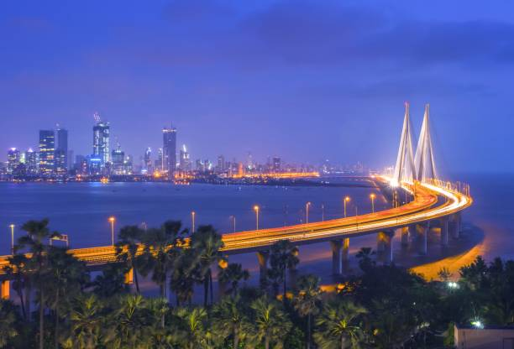
Intership projectories
Keraliya Hiren B.
Year 2023

Slide 2

Home page
This is my website’s home page

Slide 3

South India tour
This is beautiful Place
This is my Website’s south India tour image.
This is best place in India.

Slide 4

North India tour
This is amazing place
This is my website north India image.
This is very beautiful Place in India

Slide 5
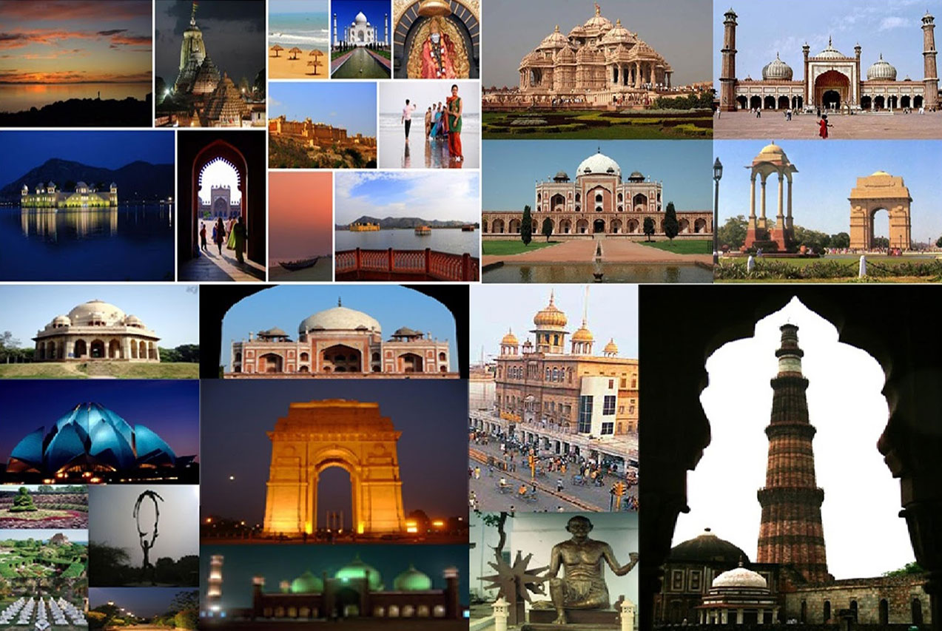
BIG IMAGE
All India tourism

Slide 6

THANK YOU!
Contact
Phone:
678-555-0128
Email:
BERGQVIST@EXAMPLE.COM

